Slide 1
Support Vector Machine (SVM)

Slide 2
Support Vector Machines (SVM)
→ Supervised learning methods for classification and regression
relatively new class of successful learning methods -
→they can represent non-linear functions and they have an efficient training algorithm
→ derived from statistical learning theory by Vapnik and Chervonenkis
(COLT-92)
→ SVM got into mainstream because of their exceptional performance in Handwritten Digit Recognition
1.1% error rate which was comparable to a very carefully constructed (and complex) ANN
Notes:
First introduced in COLT-92 by Boser, Guyon and Vapnik
COLT = computational learning theory

Slide 3
Two Class Problem: Linear Separable Case
Many decision boundaries can separate these two classes
Which one should we choose?
Class 2
Class 1
Notes:
Perceptron learning rule can be used to find any decision boundary between class 1 and class 2

Slide 4
Example of Bad Decision Boundaries
Class 2
Class 2
Class 1
Class 1

Slide 5
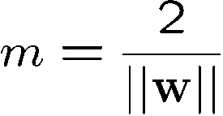





Good Decision Boundary: Margin Should Be Large
The decision boundary should be as far away from the data of both classes as possible
We should maximize the margin, m
Support vectors
datapoints that the margin
pushes up against
Class 2
The maximum margin linear
classifier is the linear classifier
with the maximum margin.
This is the simplest kind of
SVM (Called an Linear SVM)
m
Class 1

Slide 6
Good Decision Boundary: Margin Should Be Large
The maximum margin linear classifier is the linear classifier
with the maximum margin.
This is the simplest kind of SVM (Called an Linear SVM)
Support vectors datapoints that the margin touch
Class 2
m
Class 1

Slide 7

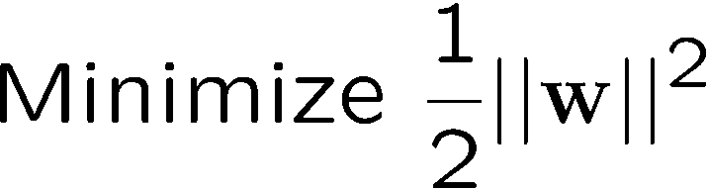
The Optimization Problem
Let {x₁, ..., x_{n}} be our data set and let y_{i} ∈ {1,-1} be the class label of x_{i}
The decision boundary should classify all points correctly ⇒
A constrained optimization problem
||w||² = w^{T}w

Slide 8
SVM with Python
Import Libraries
Get the Data
EDA
Train Test Split
Using SVM
from sklearn.svm import SVC
model = SVC()
model.fit(X_train,y_train)
predictions = model.predict(X_test)
from sklearn.metrics import classification_report,confusion_matrix
print(classification_report(y_test, predictions))

